Slide 1
Robot framework-based feature validation
A software unit validation (SWE.4) framework

Slide 2
Challenge
Context: Different platforms used at ADAS feature level for development. (model/code based)
Lack of uniform unit validation approach across features that are developed in different platforms.
Separate unit validation approaches are created/maintained (for example m-script based utility for MBD based features).
Licensing needs based on software used.
Consideration for integration into project wide tools for development and validation.
If existing support for development and validation tools across project, are yet to integrate model-based feature into common unit validation processes because those approaches are code based and find only similar modules easier to integrate first.
Parallel approaches in project may be operating at system integration level and hence, may involve considerable timelines for including features for unit level validation.
AEB
Lane Support
Contextual
ACC
Application
MATLAB/Simulink, RUST, C
Approach A
Approach B
Approach C
Unit validation
M-Script based utilities, RUST unit test, gTest

Slide 3
Challenge
Context: Different platforms used at ADAS feature level for development. (model/code-based)
Duration of unit validation run, based on approach, varies.
Existing unitary validation for model-based features are time consuming. (Depending on mapped requirements, sub module can clock several minutes for complete validation run for mbd based unit validation.)
With multiple incoming model updates based on tags/release (interface or requirement updates), the above process can rerun to consume appreciable length of time through the sprints.
AEB
Lane Support
Contextual
ACC
Application
MATLAB/Simulink, RUST, C
Approach A
Approach B
Approach C
Unit validation
M-Script based utilities, RUST unit test, gTest

Slide 4
Impact
Lack of uniform unit validation approach across features that are developed in different platforms has following impact on the project.
Unit validation approaches must be maintained based on platform on which feature is developed, (for example m-script based utility for MBD based features) which may also create additional platform-based dependencies like licenses.
Above approach causes delay in consideration for project wide tools for development and testing support, leading to rework.
Duration of unit validation run, based on approach, considerably varies for a given features, consuming appreciable time.
AEB
Lane Support
Contextual
ACC
Application
MATLAB/Simulink, RUST, C
Approach A
Approach B
Approach C
Unit validation
M-Script based utilities, RUST unit test, gTest

Slide 5
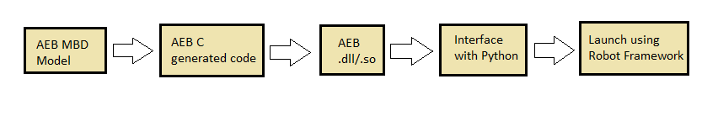
Solution
Common unit validation for feature sub modules
Open-source automation framework (Robot Framework).
Code generated from application/CI as system under test (SUT).
Generate shared library form above code.
Use library and unit validate by using input from automation framework.

Slide 6
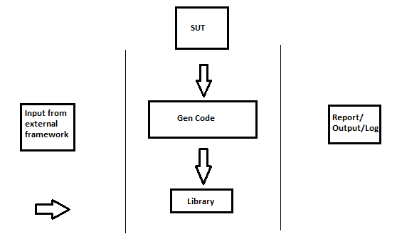
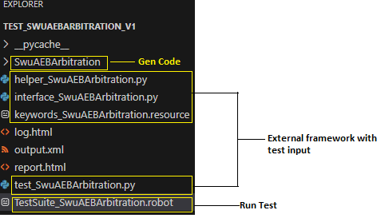
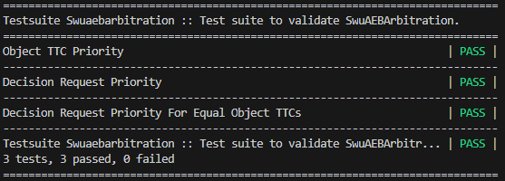
Solution
Demonstrated on sub module of a client ADAS application (model-based platform).
Validation successful on the sub module SW AEB.
Processes refinements like automation, can be implemented.
Library generation through CI jobs.
Interface files in framework corresponding to user type data in generated code of application.
Simulink model (.slx)
Generate code (.c/.h)
Generate library (.so)
Python and RF (.py, .robot, .resource)
Log Report (.html)

Slide 7
Impact of Solution
Common approach for unit validating sub modules of features.
Uniformity can help in lesser maintainability of approach on part of features.
For e.g., m-script based utility tools need not be maintained for unit validating model-based features.
Possibility to integrate with some project wide tools for development and validation, that face longer time to align with and include model-based features.
AEB
Lane Support
Contextual
ACC
Application
MATLAB/Simulink, RUST, C
Approach
Unit validation
Automation frameworks

Slide 8
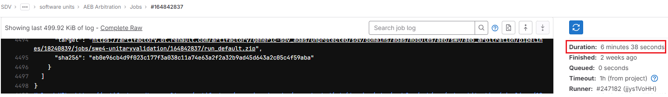
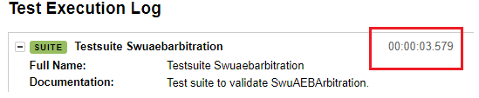
Impact of Solution
Run duration improvement (way to faster unit validation).
Reduced run duration observed for the feature sub module. (several minutes to few seconds)
Helpful for submodules with large number of software unit requirements, where unitary validation run into several minutes, with existing approach.

Slide 9
Lesson Learnt
A long-term overview of the test framework and its evolution must be addressed/discussed at SW/SYS level for the feature ecosystem, during the life of the project, while selecting approach for validation. This can reduce rework over time.
Uniform unit validation approach
1. Are features maintaining various approaches for unit validation based on platform they are developed on and is this approach optimum (run duration, tool/library maintenance, dependencies) for the feature?
2. Does capability exist to scale approach to integrate with project-wide tools?
Feature platform-based unit validation approach
Maintain/update tools/libraries based on platform
Uniform approach
Less Rework with common tools/libraries
Less Review Time needed.

Slide 10
Thank You

